Slide 1
BDD
Lesson – 5 : Cucumber

Slide 2
Lesson Objectives
In this lesson, you will learn:
Cucumber Tags
Cucumber Hooks
Background in Cucumber
Notes:
Reference : https://www.cs.colorado.edu/~kena/classes/5828/s12/lectures/09-bddcucumber.pdf

Slide 3
Cucumber Tags
We can define each scenario with a useful tag.
In the runner file, we can decide which specific tag (and so as the scenario(s)) we want Cucumber to execute.
Tag starts with “@”. After “@” you can have any relevant text to define your tag like @SmokeTests just above the scenarios you like to mark.
Then to target these tagged scenarios just specify the tags names in the CucumberOptions as tags = {“@SmokeTests”}.
Tagging not just specifically works with Scenarios, it also works with Features.
Means you can also tag your features files.
Any tag that exists on a Feature will be inherited by Scenario, Scenario Outline or Examples.
Notes:
Let’s say you have got many different feature files which cover all the different functionality of the application. Now there can be certain situation in the project where you like to execute just a SmokeTests or End2EndTests or may be RegressionTests. One approach is that you start creating new feature files with the name of the type like SmokeTests.features or End2EndTests.feature and copy paste your existing tests in the same. But this would make the project filthy and would require more maintenance in future. So how to manage execution in such cases?

Slide 4
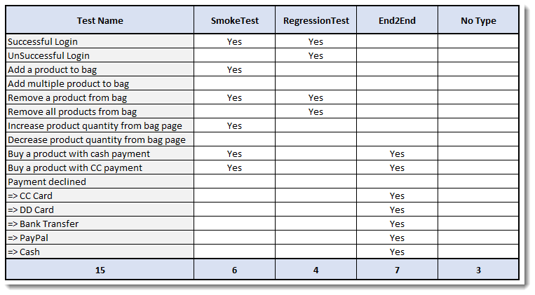
Cucumber Tags
Let’s understand this with an example.
Below is a excel sheet containing a list of scenarios of a single feature
Notes:
Let’s say you have got many different feature files which cover all the different functionality of the application. Now there can be certain situation in the project where you like to execute just a SmokeTests or End2EndTests or may be RegressionTests. One approach is that you start creating new feature files with the name of the type like SmokeTests.features or End2EndTests.feature and copy paste your existing tests in the same. But this would make the project filthy and would require more maintenance in future. So how to manage execution in such cases?

Slide 5
Cucumber Tags
In Excel file
Few scenarios are part of Smoke Test, Regression Test and End2End Test.
Few scenarios are part of two or more Test Types. For example the first test is considered as Smoke as well as Regression.
Few scenarios are not at all tagged
Last scenario of Payment Declined, it is a single scenario but has five different test data. So this will be considered as five different scenarios.
Notes:
Let’s say you have got many different feature files which cover all the different functionality of the application. Now there can be certain situation in the project where you like to execute just a SmokeTests or End2EndTests or may be RegressionTests. One approach is that you start creating new feature files with the name of the type like SmokeTests.features or End2EndTests.feature and copy paste your existing tests in the same. But this would make the project filthy and would require more maintenance in future. So how to manage execution in such cases?

Slide 6
Cucumber Tags Feature File
@FunctionalTest
Feature: ECommerce Application
@SmokeTest @RegressionTest
Scenario: Successful Login
Given This is a blank test
@RegressionTest
Scenario: UnSuccessful Login
Given This is a blank test
@SmokeTest
Scenario: Add a product to bag
Given This is a blank test
Scenario: Add multiple product to bag
Given This is a blank test
@SmokeTest @RegressionTest
Scenario: Remove a product from bag
Given This is a blank test
@RegressionTest
Scenario: Remove all products from bag
Given This is a blank test
@SmokeTest
Scenario: Increase product quantity from bag page
Given This is a blank test
Notes:
Let’s say you have got many different feature files which cover all the different functionality of the application. Now there can be certain situation in the project where you like to execute just a SmokeTests or End2EndTests or may be RegressionTests. One approach is that you start creating new feature files with the name of the type like SmokeTests.features or End2EndTests.feature and copy paste your existing tests in the same. But this would make the project filthy and would require more maintenance in future. So how to manage execution in such cases?

Slide 7
Cucumber Tags Feature File
Scenario: Decrease product quantity from bag page
Given This is a blank test
@SmokeTest @End2End
Scenario: Buy a product with cash payment
Given This is a blank test
@SmokeTest @End2End
Scenario: Buy a product with CC payment
Given This is a blank test
@End2End
Scenario Outline: Payment declined
Given This is a blank test
Examples:
|PaymentMethod|
|CC Card|
|DD Card|
|Bank Transfer|
|PayPal|
|Cash|
Notes:
Let’s say you have got many different feature files which cover all the different functionality of the application. Now there can be certain situation in the project where you like to execute just a SmokeTests or End2EndTests or may be RegressionTests. One approach is that you start creating new feature files with the name of the type like SmokeTests.features or End2EndTests.feature and copy paste your existing tests in the same. But this would make the project filthy and would require more maintenance in future. So how to manage execution in such cases?

Slide 8
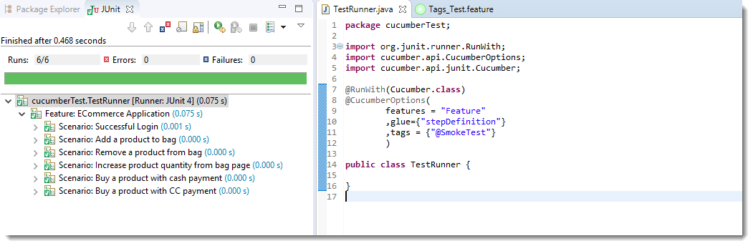
Cucumber Tags Feature File
Running single Cucumber Feature file or single Cucumber Tag
Execute all tests tagged as @SmokeTests
Notes:
Note: In the excel sheet and in the feature file paste above if you count the scenarios which are tagged as @SmokeTests, you will find the count is 6 and the same count is also displayed under Junit tab.

Slide 9
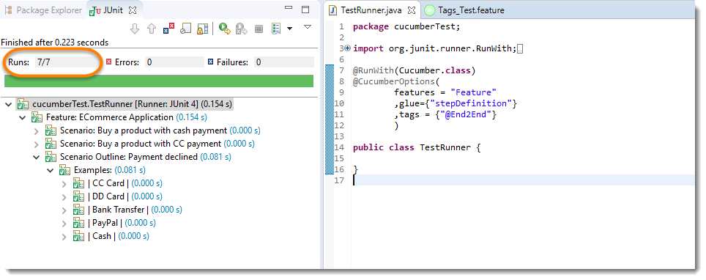
Cucumber Tags Feature File
Execute all tests tagged as @End2End
Notes:
Note: A special thing to note here is that, the last scenario Payment declined has five different data examples. So every example is considered as a separate test. Due to which the total test number is 7.

Slide 10
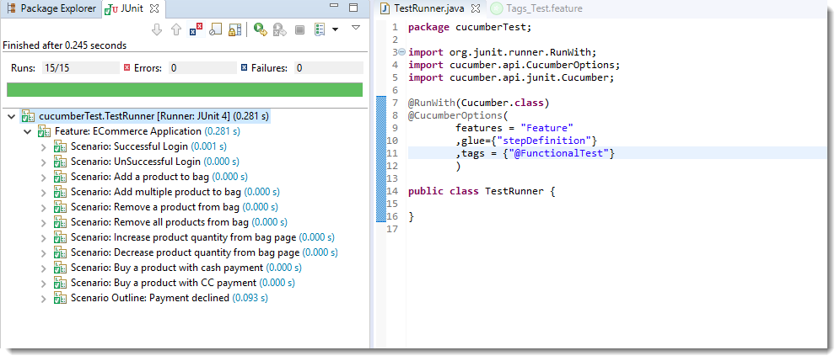
Cucumber Tags Feature File
Execute all tests of a Feature tagged as @FunctionalTest : Feature Tagging
Not only tags work with Scenario, tags work with Feature Files as well.
Feature files pasted above is also tagged as @FunctionTests.
Let’s just see how to executes all the tests in this feature.
Notes:
Note: All the test exists in the feature file are executed.

Slide 11
Cucumber Tags Feature File
Logically ANDing and ORing Tags
Execute all tests tagged as @SmokeTest OR @RegressionTest
Tags which are comma separated are ORed.
Example : tags = “@SmokeTest, @RegressionTest”
Execute all tests tagged as @SmokeTest AND @RegressionTest
Tags which are passed in separate quotes are ANDed
Example : tags = “@SmokeTest” , ”@RegressionTest”
Ignoring Cucumber Tests
This is again a good feature of Cucumber Tags that you can even skip tests in the group execution.
Special Character ~ is used to skip the tags. This also works both for Scenarios and Features.
And this can also works in conjunction with AND or OR.
Example :tags = “@SmokeTest” , ”~@RegressionTest”
Will execute all tests of the feature tagged as @FunctionalTests but skip scenarios tagged as @SmokeTest
Notes:
Note: OR means scenarios which are tagged either as @SmokeTest OR @RegressionTest.
Note: AND means the scenario which are tagged with both the tags.
There are only two scenarios in our feature file which have both tags together.

Slide 12
Cucumber Hooks
Cucumber supports hooks, which are blocks of code that run before or after each scenario.
You can define them anywhere in your project or step definition layers, using the methods @Before and @After.
Cucumber Hooks allows us to better manage the code workflow and helps us to reduce the code redundancy.
We can say that it is an unseen step, which allows us to perform our scenarios or tests.
These can be used to perform the prerequisite steps before testing any test scenario.
In the same way there are always after steps as well of the tests
Notes:
In the world of testing, you must have encountered the situations where you need to perform the prerequisite steps before testing any test scenario. This prerequisite can be anything from:
Starting a webdriver
Setting up DB connections
Setting up test data
Setting up browser cookies
Navigating to certain page
or anything before the test
In the same way there are always after steps as well of the tests like:
Killing the webdriver
Closing DB connections
Clearing the test data
Clearing browser cookies
Logging out from the application
Printing reports or logs
Taking screenshots on error
or anything after the test
To handle these kind of situations, cucumber hooks are the best choice to use. Unlike TestNG Annotaions, cucumber supports only two hooks (Before & After) which works at the start and the end of the test scenario. As the name suggests, @beforehook gets executed well before any other test scenario, and @after hook gets executed after executing the scenario.

Slide 13
Cucumber Hooks
Step Definitions
package stepDefinition;
import cucumber.api.java.en.Given;
import cucumber.api.java.en.Then;
import cucumber.api.java.en.When;
public class Hooks_Steps {
@Given("^this is the first step$")
public void This_Is_The_First_Step(){
System.out.println("This is the first step");
}
@When("^this is the second step$")
public void This_Is_The_Second_Step(){
System.out.println("This is the second step");
}
@Then("^this is the third step$")
public void This_Is_The_Third_Step(){
System.out.println("This is the third step");
}
}
Test Hooks with Single Scenario
Feature File
1 2 3 4 5 6 | Feature: Test Hooks Scenario: This scenario is to test hooks functionality Given this is the first step When this is the second step Then this is the third step
Notes:
Note: There is no logic used in the step definitions. Just printing the step summary log

Slide 14
Cucumber Hooks
Test Hooks with Single Scenario
Hooks
package utilities;
import cucumber.api.java.After;
import cucumber.api.java.Before;
public class Hooks {
@Before
public void beforeScenario(){
System.out.println("This will run before the Scenario");
}
@After
public void afterScenario(){
System.out.println("This will run after the Scenario");
}
}
Notes:
Things to note
An important thing to note about the after hook is that even in case of test fail, after hook will execute for sure.
Method name can be anything, need not to be beforeScenario() or afterScenario(). can also be named as setUp() and tearDown().
Make sure that the package import statement should be import cucumber.api.java.After; & import cucumber.api.java.Before;
Often people mistaken and import Junit Annotations, so be careful with this.

Slide 15
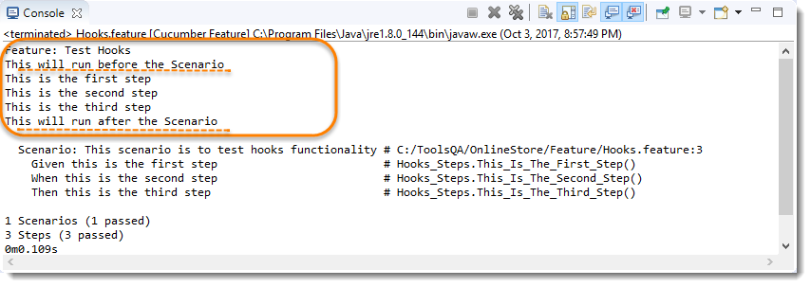
Cucumber Hooks
Test Hooks with Single Scenario
Output
Notes:
Things to note
An important thing to note about the after hook is that even in case of test fail, after hook will execute for sure.
Method name can be anything, need not to be beforeScenario() or afterScenario(). can also be named as setUp() and tearDown().
Make sure that the package import statement should be import cucumber.api.java.After; & import cucumber.api.java.Before;
Often people mistaken and import Junit Annotations, so be careful with this.

Slide 16
Background in Cucumber
Background in Cucumber is used to define a step or series of steps which are common to all the tests in the feature file.
It allows you to add some context to the scenarios for a feature where it is defined.
A Background is much like a scenario containing a number of steps. But it runs before each and every scenario where for a feature in which it is defined.
For example to purchase a product on any E-Commerce website, you need to do following steps:
Navigate to Login Page
Submit UserName and Password
After these steps only you will be able to add a product to your cart/basket and able to perform the payment. Now as we are in a feature file where we will be testing only the Add to Cart or Add to Bag functionality, these tests become common for all tests.
So instead of writing them again and again for all tests we can move it under the Background keyword.

Slide 17
Background in Cucumber
If we create a feature file of the scenario we explained above, this is how it will look like:
Feature File
Feature: Test Background Feature
Description: The purpose of this feature is to test the Background keyword
Background: User is Logged In
Given I navigate to the login page
When I submit username and password
Then I should be logged in
Scenario: Search a product and add the first product to the User basket
Given User search for Lenovo Laptop
When Add the first laptop that appears in the search result to the basket
Then User basket should display with added item
Scenario: Navigate to a product and add the same to the User basket
Given User navigate for Lenovo Laptop
When Add the laptop to the basket
Then User basket should display with added item
Notes:
Reference : http://toolsqa.com/cucumber/background-in-cucumber/

Slide 18
Background in Cucumber
In the this example, we have two different scenarios where user is adding a product from search and directly from product page.
But the common step is to log In to website for both the scenario.
This is why we creates another Scenario for Log In but named it as Background rather then a Scenario. So that it executes for both the ScenariosFeature File
Notes:
Reference : http://toolsqa.com/cucumber/background-in-cucumber/

Slide 19
Background in Cucumber
Step Definitions
public class BackGround_Steps {
@Given("^I navigate to the login page$")
public void i_navigate_to_the_login_page() throws Throwable {
System.out.println("I am at the LogIn Page");
}
@When("^I submit username and password$")
public void i_submit_username_and_password() throws Throwable {
System.out.println("I Submit my Username and Password");
}
@Then("^I should be logged in$")
public void i_should_be_logged_in() throws Throwable {
System.out.println("I am logged on to the website");
}
@Given("^User search for Lenovo Laptop$")
public void user_searched_for_Lenovo_Laptop() throws Throwable {
System.out.println("User searched for Lenovo Laptop");
}
@When("^Add the first laptop that appears in the search result to the basket$")
public void add_the_first_laptop_that_appears_in_the_search_result_to_the_basket() throws Throwable {
System.out.println("First search result added to bag");
}
@Then("^User basket should display with added item$")
public void user_basket_should_display_with_item() throws Throwable {
System.out.println("Bag is now contains the added product");
}
@Given("^User navigate for Lenovo Laptop$")
public void user_navigate_for_Lenovo_Laptop() throws Throwable {
System.out.println("User navigated for Lenovo Laptop");
}
@When("^Add the laptop to the basket$")
public void add_the_laptop_to_the_basket() throws Throwable {
System.out.println("Laptop added to the basket");
}
}
Notes:
Reference : http://toolsqa.com/cucumber/background-in-cucumber/

Slide 20
Background in Cucumber
Output
Feature: Test Background Feature
Description: The purpose of this feature is to test the Background keyword
I am at the LogIn Page
I Submit my Username and Password
I am logged on to the website
User searched for Lenovo Laptop
First search result added to bag
Bag is now contains the added product
I am at the LogIn Page
I Submit my Username and Password
I am logged on to the website
User navigated for Lenovo Laptop
Laptop added to the basket
Bag is now contains the added product
The background ran two times in the feature before each scenario.
Notes:
Reference : http://toolsqa.com/cucumber/background-in-cucumber/

Slide 21
Background in Cucumber
Background with Hooks
This is so interesting to see the working of Background with Hooks. The background is run before each of your scenarios but after any of your @Before hook.
To get it straight, let’s assign a task to the Before & After Hookin the same test.
@Before: Print the starting logs
@Before: Start browser and Clear the cookies
@After: Close the browser
@After: Print the closing logs
Notes:
Reference : http://toolsqa.com/cucumber/background-in-cucumber/

Slide 22
Background in Cucumber
Hooks File
import cucumber.api.java.After;
import cucumber.api.java.Before;
public class Hooks {
@Before(order=1)
public void beforeScenario(){
System.out.println("Start the browser and Clear the cookies");
}
@Before(order=0)
public void beforeScenarioStart(){
System.out.println("-----------------Start of Scenario-----------------");
}
@After(order=0)
public void afterScenarioFinish(){
System.out.println("-----------------End of Scenario-----------------");
}
@After(order=1)
public void afterScenario(){
System.out.println("Log out the user and close the browser");
}
}
Notes:
Reference : http://toolsqa.com/cucumber/background-in-cucumber/

Slide 23
Background in Cucumber
Output
Feature: Test Background Feature
Description: The purpose of this feature is to test the Background keyword
-----------------Start of Scenario-----------------
Start the browser and Clear the cookies
I am at the LogIn Page
I Submit my Username and Password
I am logged on to the website
User searched for Lenovo Laptop
First search result added to bag
Bag is now contains the added product
Log out the user and close the browser
-----------------End of Scenario-----------------
-----------------Start of Scenario-----------------
Start the browser and Clear the cookies
I am at the LogIn Page
I Submit my Username and Password
I am logged on to the website
User navigated for Lenovo Laptop
Laptop added to the basket
Bag is now contains the added product
Log out the user and close the browser
-----------------End of Scenario-----------------
Notes:
Reference : http://toolsqa.com/cucumber/background-in-cucumber/

Slide 24
Summary
In this lesson, you have learnt :
Cucumber Tags
Cucumber Hooks
Background in Cucumber

Slide 25
Review Question
Question 1: Which of the below is used as a hook in Cucumber?
When
Then
After
Result
Notes:
Q.4.getTitle()
Q.5.True
Q.6. sendKeys()

